Slide 1


Guidelines
Use this template to submit your Idea brief for the hackathon.
The ideal size of the presentation should not be more than 10 slides.
While in this stage the evaluation will only be made on the basis of the idea, you are welcome to add as many POCs and design concepts to support your idea, if already prepared.
The idea should be feasible and the team members should be capable enough, to come up with the prototype of the same idea if required.
In case of queries drop in a mail at support@hack2skill.com

Slide 2

Team Name : GEN EXPENDABLES
Problem Statement : Data-Driven Traffic Congestion

Slide 3
Brief about the Idea:
Developing an AI-based system that can analyze traffic patterns, optimize traffic management, and reduce congestion in a city, with the goal of creating a product for the GEN AI BUILDATHON.

Slide 4
Opportunity :
Visualize Traffic Volume, Density, and Speed for Optimal Capacity. Say goodbye to Congestion Duration and Queue Length as you explore the number of cars on the road, the speed of traffic, and the location of traffic congestion across different parts of the city on a dynamic daily, weekly, and monthly basis!"
How different is it from any other existing ideas out there?
While there might be existing solutions that offer some of these features individually, the combination of real-time data visualization, comprehensive traffic metrics, location-specific congestion mapping, flexibility in time analysis, optimization and capacity planning, user-friendly interface, and integration with existing infrastructure sets the proposed solution apart from traditional traffic management systems in the market
How will it be able to solve the problem?
Our solution for the AI hackathon utilizes Tableau's distinct features to revolutionize traffic management. With robust forecasting, seamless real-time data integration, interactive visualizations, flexible customization, collaborative functionalities, and scalable design, our solution optimizes traffic and reduces congestion like never before.

Slide 5
POCs
PoC 1: Develop a system that can identify areas of congestion and suggest ways to improve traffic flow. This could be done by using AI to analyze traffic data and identify patterns that indicate congestion. The system could then suggest ways to improve traffic flow.
PoC 2: Develop a system that can predict traffic congestion. This could be done by using AI to analyze historical traffic data and identify patterns that can be used to predict future congestion. The system could then provide alerts to drivers and city officials about upcoming congestion so that they can take steps to mitigate it.
PoC 3: Develop a system that can recommend alternative routes to drivers. This could be done by using AI to analyze traffic data and identify the best routes for drivers to take. The system could then provide drivers with real-time recommendations for alternative routes.

Slide 6
Design Concepts
System architecture: The system should be designed as a distributed system, with multiple components that can communicate with each other. This will allow the system to scale to handle large amounts of data and to operate in real-time.
Data collection: The system should collect data from a variety of sources, such as traffic cameras, GPS data, and sensors embedded in vehicles. This data should be stored in a central database so that it can be easily accessed by the other components of the system.
Data analysis: The system should use AI to analyze the collected data and identify patterns that can be used to optimize traffic management. For example, the system could identify areas of congestion and suggest ways to improve traffic flow.
Traffic management: The system should be able to make real-time adjustments to traffic signals, lane closures, and other traffic controls. This will help to reduce congestion and improve traffic flow.
User interface: The system should have a user-friendly interface that allows drivers and city officials to interact with the system. The interface should be easy to use and understand, and it should provide users with the information they need to make informed decisions about their travel.

Slide 7
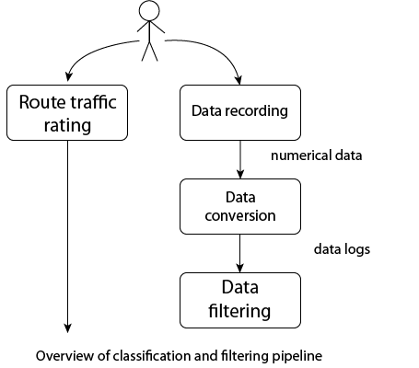
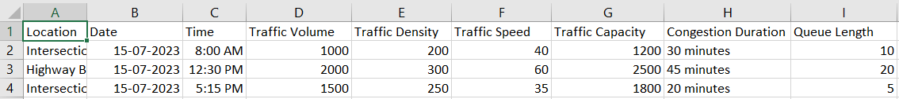
List of features offered by the solution :
Will use traffic data as input, and use features in Tableau to make a dashboard for presentation.

Slide 8
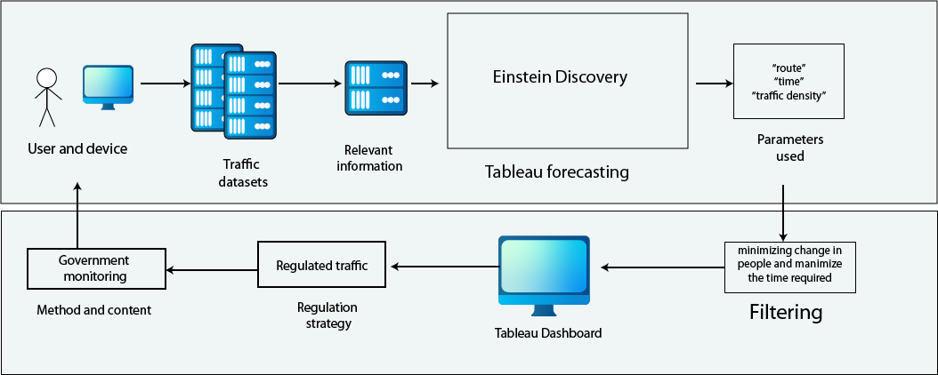
Process Flow Diagram / Use-case Diagram:
Process Flow Diagram

Slide 9
Business Logic of the solution :
People should be interested in and support the idea of using Tableau dashboards for traffic congestion solutions because it enables data-driven decision making, cost savings, reduced environmental impact, improved productivity, and enhanced business operations.
Business logical solutions include route optimization, demand forecasting, customer segmentation, supply chain visibility, and collaboration with stakeholders.
Quantitatively, investing in Tableau dashboards can lead to cost savings, increased revenue, improved productivity, and a better commuting experience.

Slide 10
Technology used : Tableau, Tableau forecasting.

Slide 11
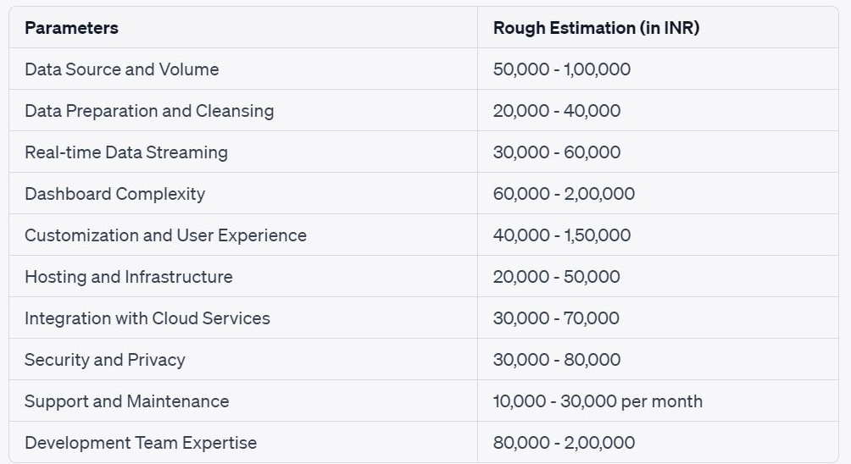
Estimated cost of/after implementing the solution

Slide 12
Steps / Working to USE Dashboard
Select the Filters like Year, Quarter, Region
According to the filters selected the dashboard will display Information.
When you click on one city in the map the whole dashboard will filter data according to the city selected Example: Bangalore
It helps to get info like city traffic distribution, prediction based on date, and the top 10 areas with the largest congestion duration by factor 1 and factor 2.
Scatter plot tells us Traffic at different levels of Roads
Heat map gives info regarding traffic congestion in different months

Slide 13
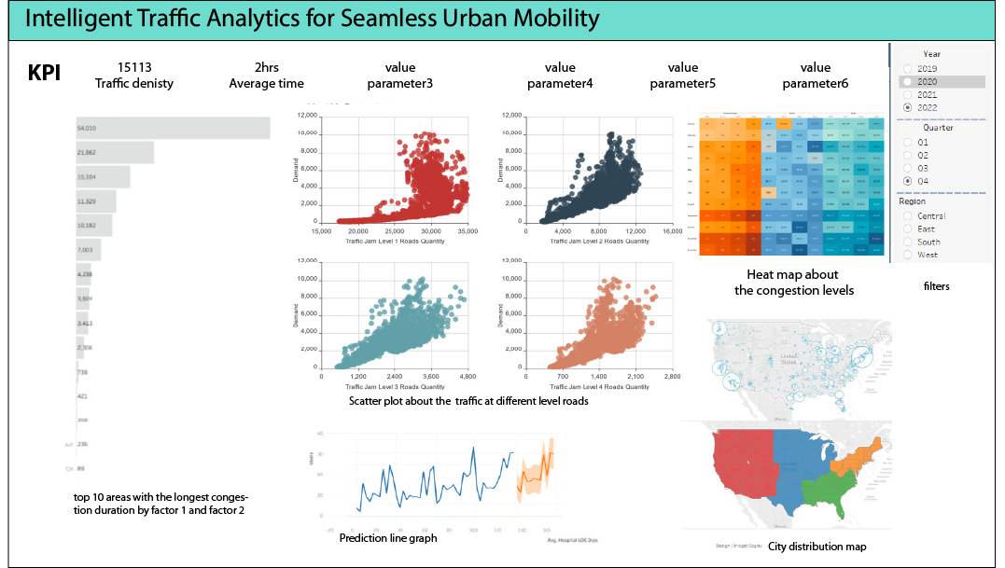

Slide 14


